Slide 1
CHAPTER 6
Basic SQL

Slide 2
Basic SQL
SQL language
Considered one of the major reasons for the commercial success of relational databases
SQL
The origin of SQL is relational predicate calculus called tuple calculus (see Ch.8) which was proposed initially as the language SQUARE.
SQL Actually comes from the word “SEQUEL” which was the original term used in the paper: “SEQUEL TO SQUARE” by Chamberlin and Boyce. IBM could not copyright that term, so they abbreviated to SQL and copyrighted the term SQL.
Now popularly known as “Structured Query language”.
SQL is an informal or practical rendering of the relational data model with syntax

Slide 3
The CREATE TABLE Command in SQL
Specifying a new relation
Provide name of table
Specify attributes, their types and initial constraints
Can optionally specify schema:
CREATE TABLE COMPANY.EMPLOYEE ...
or
CREATE TABLE EMPLOYEE ...

Slide 4
The CREATE TABLE Command in SQL (cont’d.)
Base tables (base relations)
Relation and its tuples are actually created and stored as a file by the DBMS
Virtual relations (views)
Created through the CREATE VIEW statement. Do not correspond to any physical file.

Slide 5
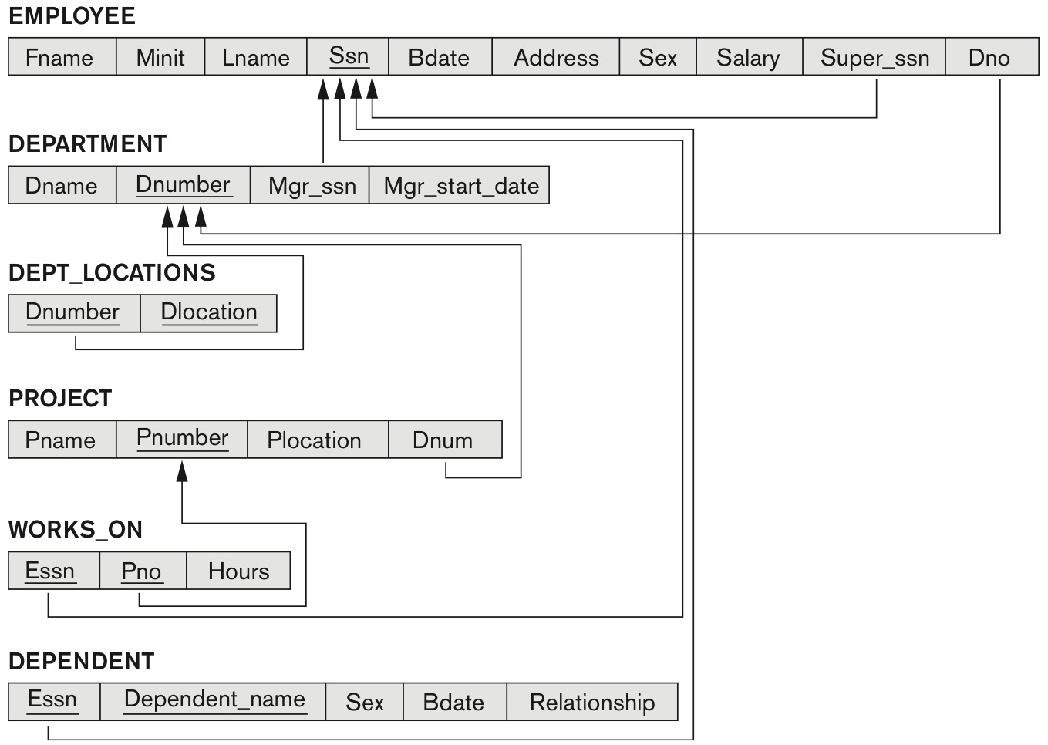
COMPANY relational database schema (Fig. 5.7)

Slide 6
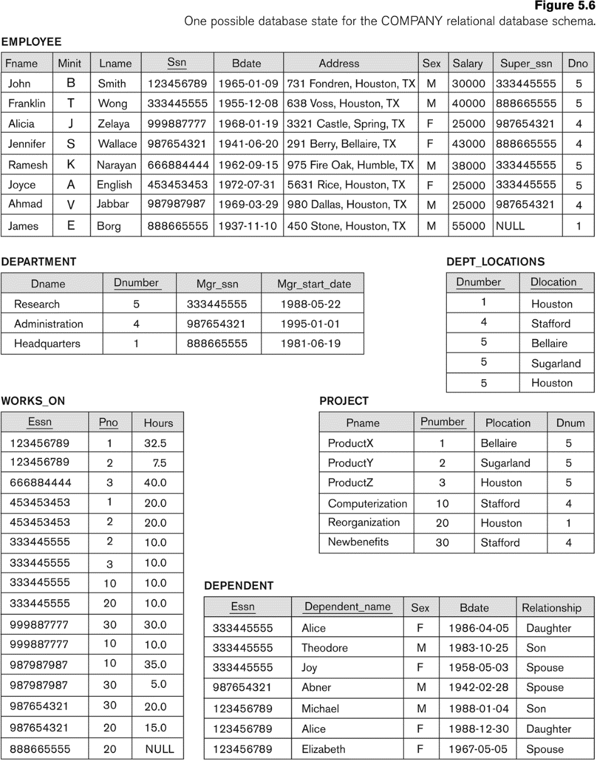
Create DB named as CWNUEMS and then create schema of the given tables, then INSERT data. Later on we will perform queries.

Slide 7
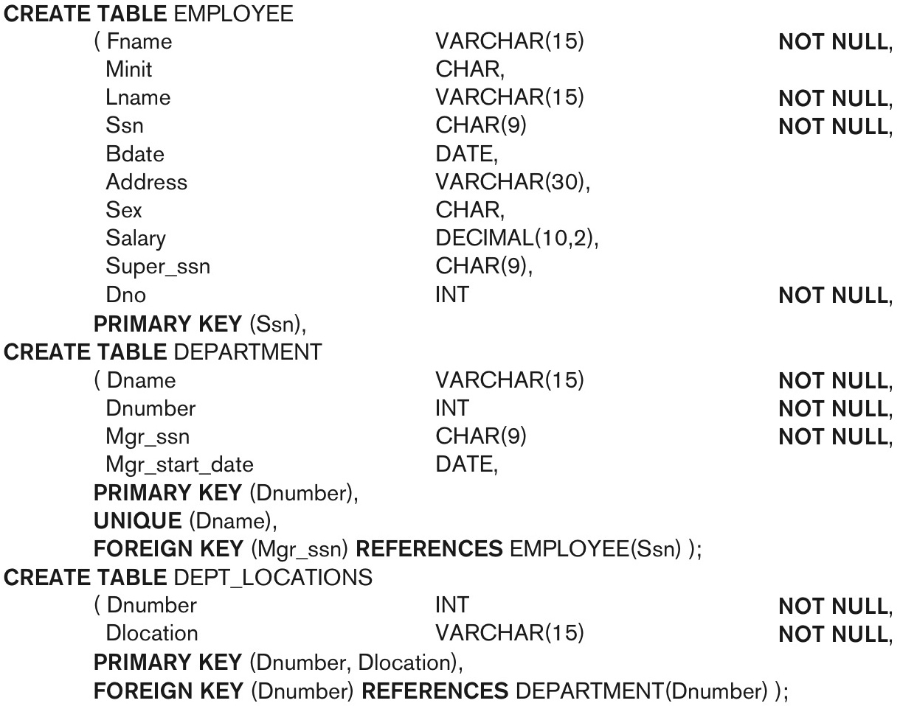
continued on next slide

Slide 8
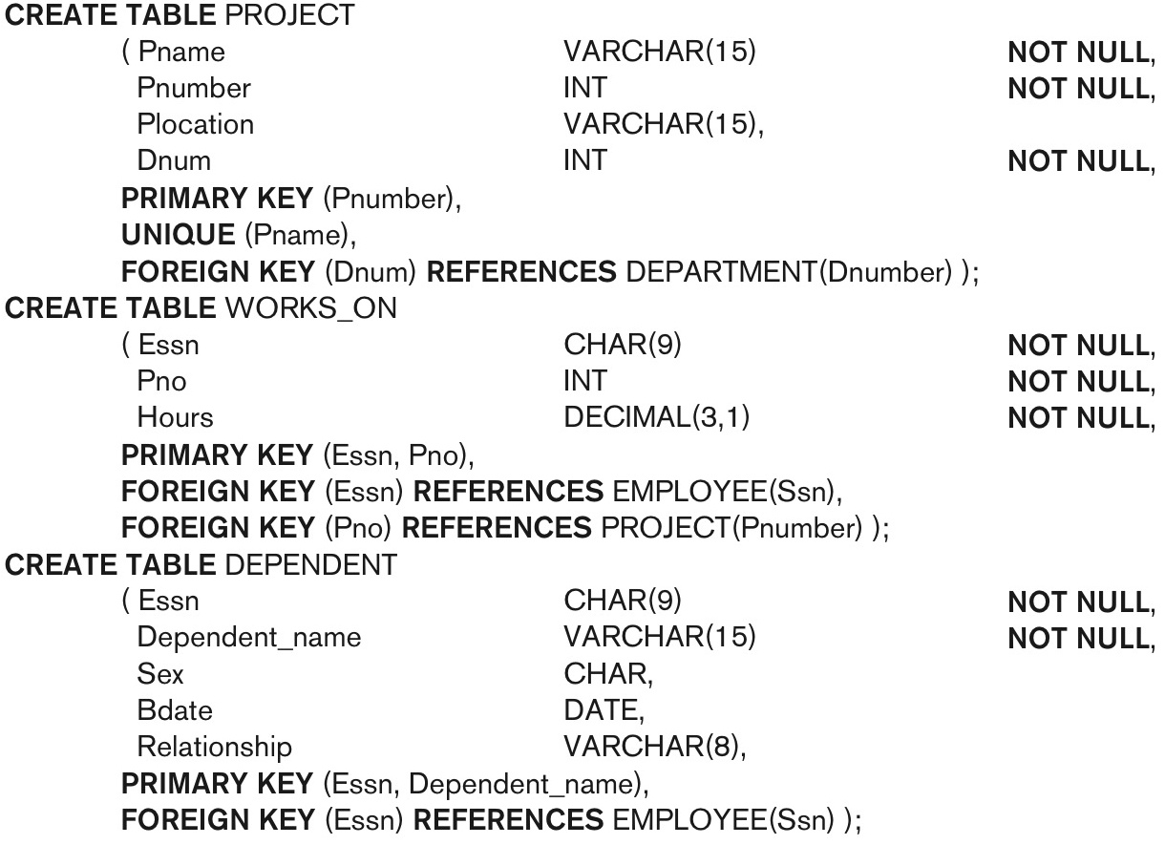
SQL CREATE TABLE data definition statements for defining the COMPANY schema from Figure 5.7 (Fig. 6.1)-continued

Slide 9
Specifying Constraints in SQL
Basic constraints:
Relational Model has 3 basic constraint types that are supported in SQL:
Key constraint: A primary key value cannot be duplicated
Entity Integrity Constraint: A primary key value cannot be null
Referential integrity constraints : The “foreign key “ must have a value that is already present as a primary key, or may be null.

Slide 10
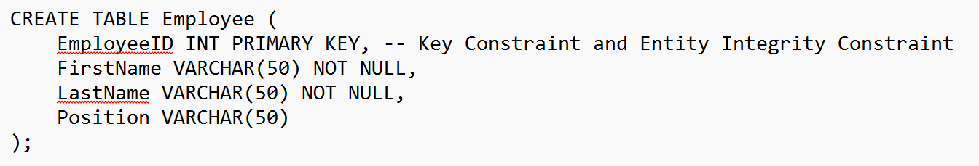
Key Constraint: Ensures that each value in the primary key column is unique and cannot be duplicated.
Entity Integrity Constraint: Ensures that a primary key column cannot contain NULL values.

Slide 11
INSERT INTO Employee (EmployeeID, FirstName, LastName, Position)
VALUES (1, 'John', 'Doe', 'Manager');
-- This will throw an error because EmployeeID 1 already exists
INSERT INTO Employee (EmployeeID, FirstName, LastName, Position)
VALUES (1, 'Jane', 'Smith', 'Analyst');
Violating Key Constraint
-- This will throw an error because EmployeeID cannot be NULL
INSERT INTO Employee (EmployeeID, FirstName, LastName, Position)
VALUES (NULL, 'Alice', 'Johnson', 'Developer');
Violating Entity Integrity Constraint:

Slide 12
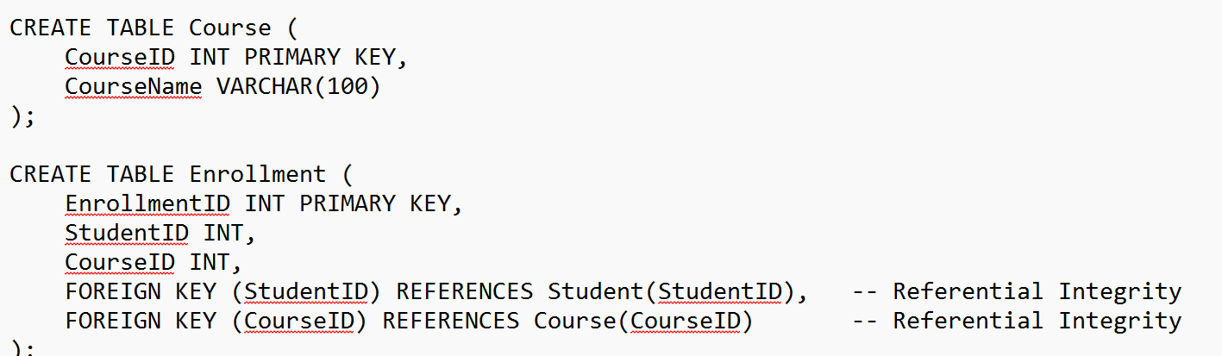
This constraint ensures that a foreign key value must match a primary key value in another table, or it can be NULL.

Slide 13
Specifying Attribute Constraints
Other Restrictions on attribute domains:
Default value of an attribute
DEFAULT <value>
NULL is not permitted for a particular attribute (NOT NULL)
CHECK clause
Dnumber INT NOT NULL CHECK (Dnumber > 0 AND Dnumber < 21);

Slide 14
Specifying Key and Referential Integrity Constraints
PRIMARY KEY clause
Specifies one or more attributes that make up the primary key of a relation
Dnumber INT PRIMARY KEY;
UNIQUE clause
Specifies alternate (secondary) keys (called CANDIDATE keys in the relational model).
Dname VARCHAR(15) UNIQUE;

Slide 15
Specifying Key and Referential Integrity Constraints (cont’d.)
FOREIGN KEY clause
Default operation: reject update on violation
Attach referential triggered action clause
Options include SET NULL, CASCADE, and SET DEFAULT
Action taken by the DBMS for SET NULL or SET DEFAULT is the same for both ON DELETE and ON UPDATE
CASCADE option suitable for “relationship” relations

Slide 16
ON CLAUSE
The ON Clause is used in SQL joins to specify the join conditions.
It separates the join condition from other search conditions, making the code easy to understand.
The ON Clause can be used to join columns that have different names.
The purpose of the ON clause is to define how the tables should be joined and how the records should be matched
In contrast, the WHERE clause is used to specify the filtering conditions and define which rows should be kept in the result set2.

Slide 17
ON CLAUSE
The ON clause is used in SQL to specify the condition for joining two tables. It defines which columns from each table should be matched for the join to occur, making it a critical part of INNER JOIN, LEFT JOIN, RIGHT JOIN, and FULL OUTER JOIN statements.

Slide 18
IN CLAUSE
An "IN clause" is a SQL statement used to specify multiple values in a WHERE clause.
It is mainly used to filter records that match any of the specified values in a column.
For example, SELECT * FROM table_name WHERE column_name IN (value1, value2, value3); would return all records where the column's value matches any of the values listed.

Slide 19
Giving Names to Constraints
Using the Keyword CONSTRAINT
Name a constraint
Useful for later altering

Slide 20
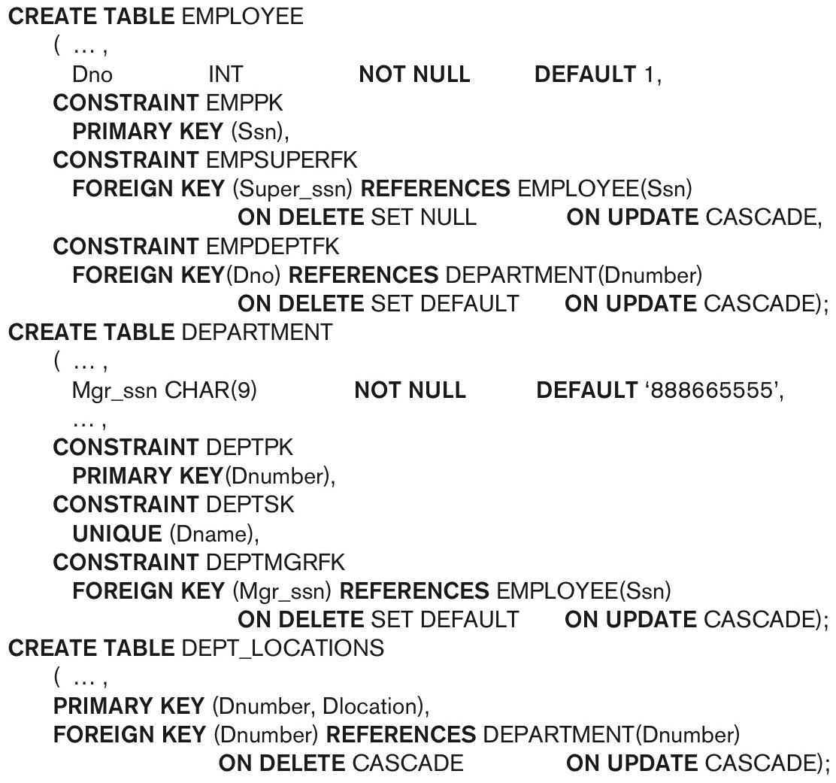
Default attribute values and referential integrity triggered action specification (Fig. 6.2)

Slide 21
Specifying Constraints on Tuples Using CHECK
Additional Constraints on individual tuples within a relation are also possible using CHECK
CHECK clauses at the end of a CREATE TABLE statement
Apply to each tuple individually
CHECK (Dept_create_date <= Mgr_start_date);

Slide 22
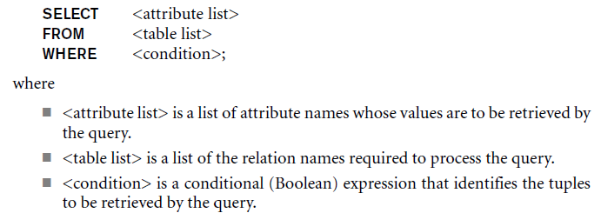
The SELECT-FROM-WHERE Structure of Basic SQL Queries
Basic form of the SELECT statement:

Slide 23
The SELECT-FROM-WHERE Structure of Basic SQL Queries (cont’d.)
Logical comparison operators
=, <, <=, >, >=, and <>
Projection attributes
Attributes whose values are to be retrieved
Selection condition
Boolean condition that must be true for any retrieved tuple. Selection conditions include join conditions (see Ch.8) when multiple relations are involved.

Slide 24
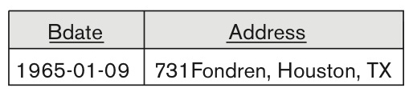
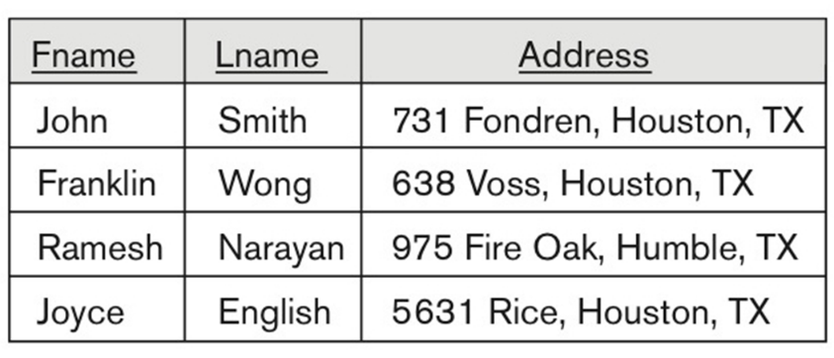
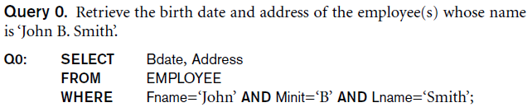
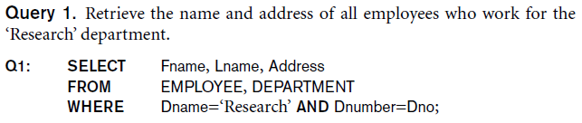
Basic Retrieval Queries

Slide 25
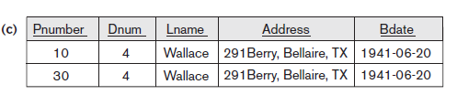
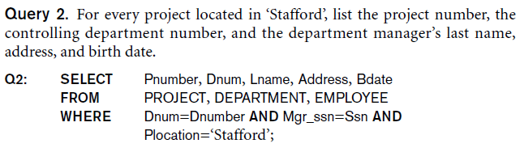
Basic Retrieval Queries (Contd.)

Slide 26

Ambiguous Attribute Names
Same name can be used for two (or more) attributes in different relations
As long as the attributes are in different relations
Must qualify the attribute name with the relation name to prevent ambiguity

Slide 27
Aliasing, and Renaming
Aliases or tuple variables
Declare alternative relation names E and S to refer to the EMPLOYEE relation twice in a query:
Query 8. For each employee, retrieve the employee’s first and last name and the first and last name of his or her immediate supervisor.
SELECT E.Fname, E.Lname, S.Fname, S.Lname
FROM EMPLOYEE AS E, EMPLOYEE AS S
WHERE E.Super_ssn=S.Ssn;
Recommended practice to abbreviate names and to prefix same or similar attribute from multiple tables.

Slide 28
Aliasing,Renaming and Tuple Variables (contd.)
The attribute names can also be renamed
EMPLOYEE AS E(Fn, Mi, Ln, Ssn, Bd, Addr, Sex, Sal, Sssn, Dno)
Note that the relation EMPLOYEE now has a variable name E which corresponds to a tuple variable
The “AS” may be dropped in most SQL implementations

Slide 29
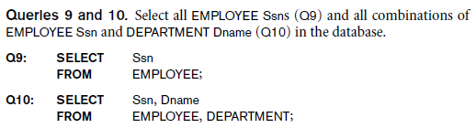
Unspecified WHERE Clause and Use of the Asterisk
Missing WHERE clause
Indicates no condition on tuple selection
Effect is a CROSS PRODUCT
Result is all possible tuple combinations (or the Algebra operation of Cartesian Product– see Ch.8) result

Slide 30
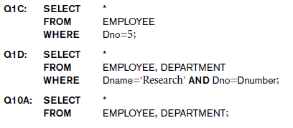
Unspecified WHERE Clause and Use of the Asterisk (cont’d.)
Specify an asterisk (*)
Retrieve all the attribute values of the selected tuples
The * can be prefixed by the relation name; e.g., EMPLOYEE *

Slide 31
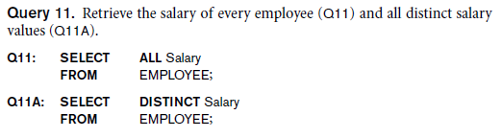
Tables as Sets in SQL
SQL does not automatically eliminate duplicate tuples in query results
For aggregate operations (See sec 7.1.7) duplicates must be accounted for
Use the keyword DISTINCT in the SELECT clause
Only distinct tuples should remain in the result

Slide 32
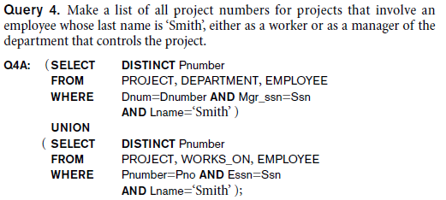
Tables as Sets in SQL (cont’d.)
Set operations
UNION, EXCEPT (difference), INTERSECT
Corresponding multiset operations: UNION ALL, EXCEPT ALL, INTERSECT ALL)
Type compatibility is needed for these operations to be valid

Slide 33
Substring Pattern Matching and Arithmetic Operators
LIKE comparison operator
Used for string pattern matching
% replaces an arbitrary number of zero or more characters
underscore (_) replaces a single character
Examples: WHERE Address LIKE ‘%Houston,TX%’;
WHERE Ssn LIKE ‘_ _ 1_ _ 8901’;
BETWEEN comparison operator
E.g., in Q14 :
WHERE(Salary BETWEEN 30000 AND 40000)
AND Dno = 5;

Slide 34
Arithmetic Operations
Standard arithmetic operators:
Addition (+), subtraction (–), multiplication (*), and division (/) may be included as a part of SELECT
Query 13. Show the resulting salaries if every employee working on the ‘ProductX’ project is given a 10 percent raise.
SELECT E.Fname, E.Lname, 0.1 * E.Salary AS Increased_sal
FROM EMPLOYEE AS E, WORKS_ON AS W, PROJECT AS P
WHERE E.Ssn=W.Essn AND W.Pno=P.Pnumber AND P.Pname=‘ProductX’;

Slide 35
Ordering of Query Results
Use ORDER BY clause
Keyword DESC to see result in a descending order of values
Keyword ASC to specify ascending order explicitly
Typically placed at the end of the query
ORDER BY D.Dname DESC, E.Lname ASC, E.Fname ASC

Slide 36
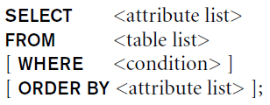
Basic SQL Retrieval Query Block

Slide 37
INSERT, DELETE, and UPDATE Statements in SQL
Three commands used to modify the database:
INSERT, DELETE, and UPDATE
INSERT typically inserts a tuple (row) in a relation (table)
UPDATE may update a number of tuples (rows) in a relation (table) that satisfy the condition
DELETE may also update a number of tuples (rows) in a relation (table) that satisfy the condition

Slide 38
INSERT
In its simplest form, it is used to add one or more tuples to a relation
Attribute values should be listed in the same order as the attributes were specified in the CREATE TABLE command
Constraints on data types are observed automatically
Any integrity constraints as a part of the DDL specification are enforced

Slide 39

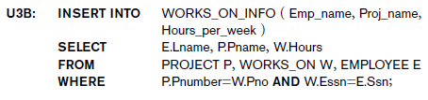
The INSERT Command
Specify the relation name and a list of values for the tuple. All values including nulls are supplied.
The variation below inserts multiple tuples where a new table is loaded values from the result of a query.

Slide 40
BULK LOADING OF TABLES
Another variation of INSERT is used for bulk-loading of several tuples into tables
A new table TNEW can be created with the same attributes as T and using LIKE and DATA in the syntax, it can be loaded with entire data.
EXAMPLE:
CREATE TABLE D5EMPS LIKE EMPLOYEE
(SELECT E.*
FROM EMPLOYEE AS E
WHERE E.Dno=5)
WITH DATA;

Slide 41
DELETE
Removes tuples from a relation
Includes a WHERE-clause to select the tuples to be deleted
Referential integrity should be enforced
Tuples are deleted from only one table at a time (unless CASCADE is specified on a referential integrity constraint)
A missing WHERE-clause specifies that all tuples in the relation are to be deleted; the table then becomes an empty table
The number of tuples deleted depends on the number of tuples in the relation that satisfy the WHERE-clause

Slide 42
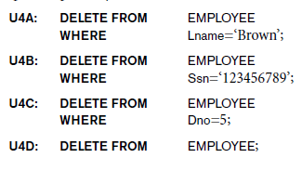
The DELETE Command
Removes tuples from a relation
Includes a WHERE clause to select the tuples to be deleted. The number of tuples deleted will vary.

Slide 43
UPDATE
Used to modify attribute values of one or more selected tuples
A WHERE-clause selects the tuples to be modified
An additional SET-clause specifies the attributes to be modified and their new values
Each command modifies tuples in the same relation
Referential integrity specified as part of DDL specification is enforced

Slide 44
UPDATE (contd.)
Example: Change the location and controlling department number of project number 10 to 'Bellaire' and 5, respectively
U5: UPDATE PROJECT SET PLOCATION = 'Bellaire', DNUM = 5 WHERE PNUMBER=10

Slide 45
UPDATE (contd.)
Example: Give all employees in the 'Research' department a 10% raise in salary.
U6: UPDATE EMPLOYEE SET SALARY = SALARY *1.1 WHERE DNO IN (SELECT DNUMBER FROM DEPARTMENT WHERE DNAME='Research')
In this request, the modified SALARY value depends on the original SALARY value in each tuple
The reference to the SALARY attribute on the right of = refers to the old SALARY value before modification
The reference to the SALARY attribute on the left of = refers to the new SALARY value after modification

